Slide 1


Rider Target Audience Analysis

Slide 2
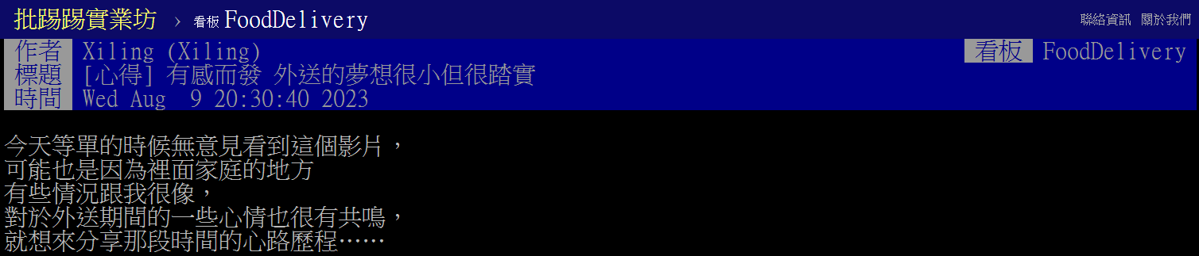
Information
Comment：117
Valid comment：97
Reason for becoming a rider

Slide 3
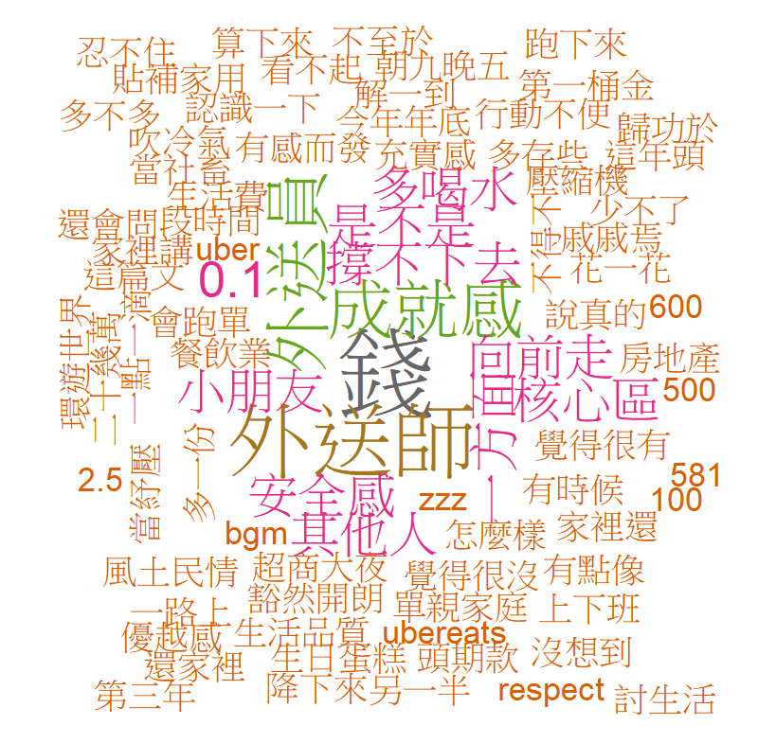
Reason for becoming a rider
Money
Self-actualization
Family
Macro environment

Slide 4
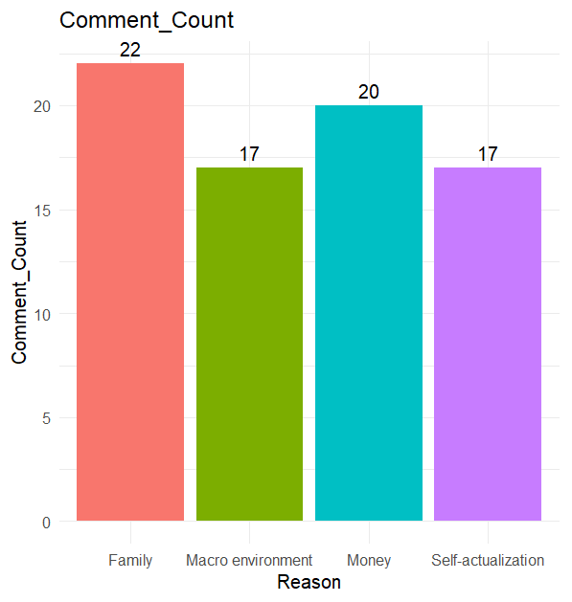
Reason for becoming a rider
Keyword
Money
薪水、萬、房、款、收入、存
Self-actualization
時間、健康、自由、夢想、生活、創業、成就感
Family
家、孩、父、母、爸、媽
Macro environment
疫情、討生活、轉行、機會

Slide 5
Conclusion
The main reasons for becoming a delivery person are:
Money
Family
Self-fulfillment
Environmental factors
After setting the keywords:
The proportion of comments for each of the four reasons is similar.
It is believed that all four factors could be the main reasons for becoming a rider.

